Slide 1
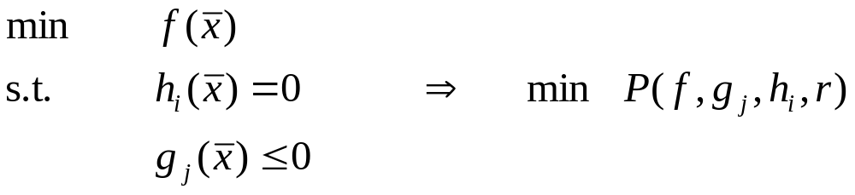
Penalty Methods – General Idea
Idea: instead of constraining the problem, add a term to the objective function which makes the function value worse as the constraint is more violated
So convert
where P is a penalty function and r is a positive penalty parameter
CPE 778, Lect. 19

Slide 2
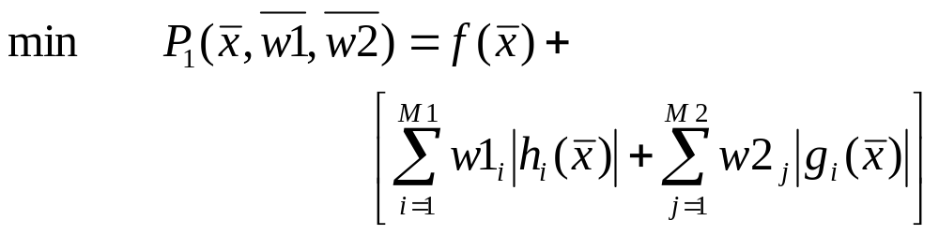
Another Idea – the L₁ Penalty Function
So the original penalty function gives an ill-conditioned matrix as soon as r gets large enough to help solve the constrained NLP. Can we use a different function?
The L₁ penalty function replaces the r with finite weights, and avoids squaring the constraint:
CPE 778, Lect. 19

Slide 3
The L₁ Penalty Function
Advantages:
  Works for large but finite values of the weighting parameters
Disadvantages:
  Discontinuous at h_{i}(x)=0, so taking derivatives may not be possible at that important point
  What type of solutions are obtained in the intermediate steps leading to the optimum?
  Infeasible ones!
CPE 778, Lect. 19

Slide 4
Infeasible Intermediate Solutions
Why do we care about the feasibility of intermediate points?
feasible region
If we never do find the optimum of a large NLP, we might choose to run at a nonoptimal, feasible point. This cannot be done if intermediate solutions are infeasible
CPE 778, Lect. 19

Slide 5
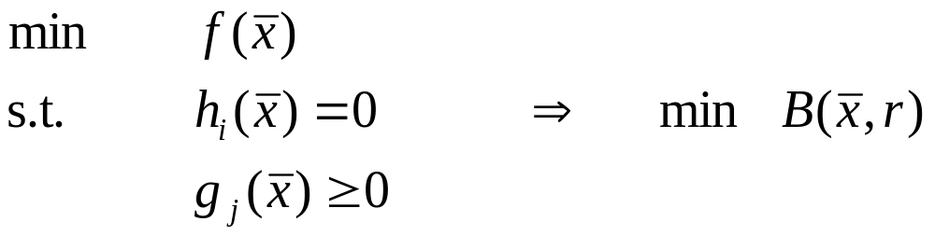
Barrier Methods – General Idea
Remember we are trying to solve a constrained NLP by converting it to an unconstrained problem
Idea: subtract a term from the objective function which goes to -∞ as we get near the constraint boundary
Again, convert
where B is a barrier function and r is a positive barrier parameter
CPE 778, Lect. 19

Slide 6
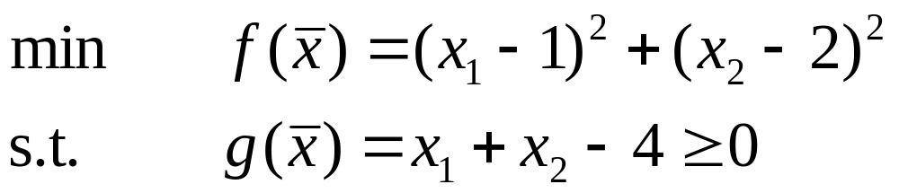
Example
Note the solution to the unconstrained problem, [1,2], is infeasible to the constrained problem
4.0
3.0
2.5
2.0
x₂
1.5
1.0
Thus the constraint must be active at optimality
0.5
0.5
1.0
1.5
2.0
2.5
3.0
3.5
4.0
x₁
CPE 778, Lect. 19

Slide 7
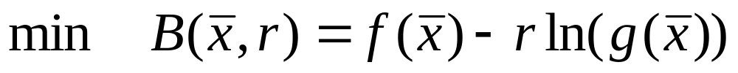

Example
We can write a logrithmic barrier function as
or for our example
What are the limiting cases here?
CPE 778, Lect. 19

Slide 8
Example, continued
For a given positive r, how does the solution to this problem relate to the solution of the original problem?
We get a feasible, nonoptimal solution to the original problem
For very small r, we get very close to the constrained optimum on the feasible side
CPE 778, Lect. 19

Slide 9
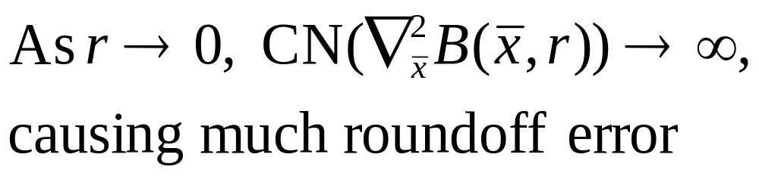
Problems with Barrier Functions
First problem: ln is discontinuous/undefined in areas of interest
Second problem:
So this method isn’t used directly either, but these functions are used within many other algorithms
CPE 778, Lect. 19

Slide 10
Successive Linear Programming: A method which really works!
A different idea: relax the constrained NLP to an LP, not an unconstrained NLP
Use Taylor series to linearize everything
Derive a series of improved linear approximations to converge on the NLP solution
CPE 778, Lect. 20

Slide 11
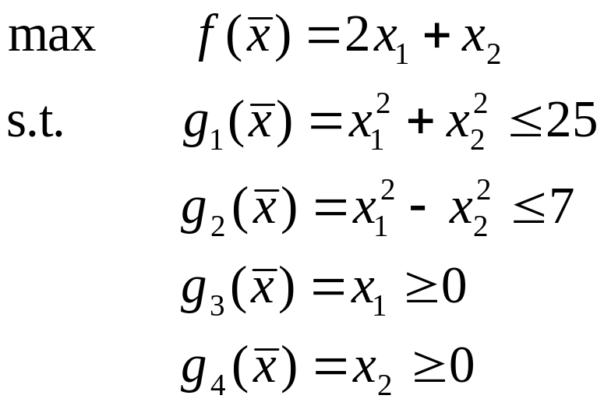

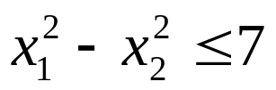
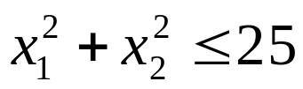
Another Example
6
5
4
x₂
3
2
1
1
2
3
4
5
6
7
8
x₁
Note the optimum lies at [4,3], on the contour f(x)=11
Also, [2,2] is a feasible starting point
CPE 778, Lect. 20

Slide 12

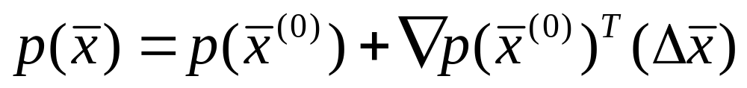
Performing the Linearizations
SLP requires an initial feasible point. We’ll start with [2,2]
We must linearize all constraints and the objective function, so we allow no discontinuous or nondifferentiable functions in the problem
Write the problem in terms of the change in each variable
The general formula for linearizing any function is:
CPE 778, Lect. 20

Slide 13
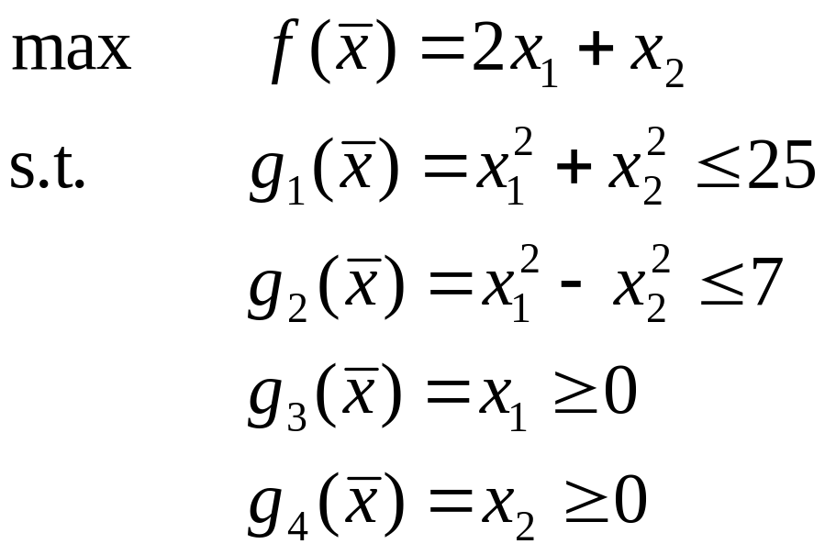
Setting up an LP subproblem
OK, now write a Taylor series approximation to each function, around the point [2,2]
CPE 778, Lect. 20

Slide 14
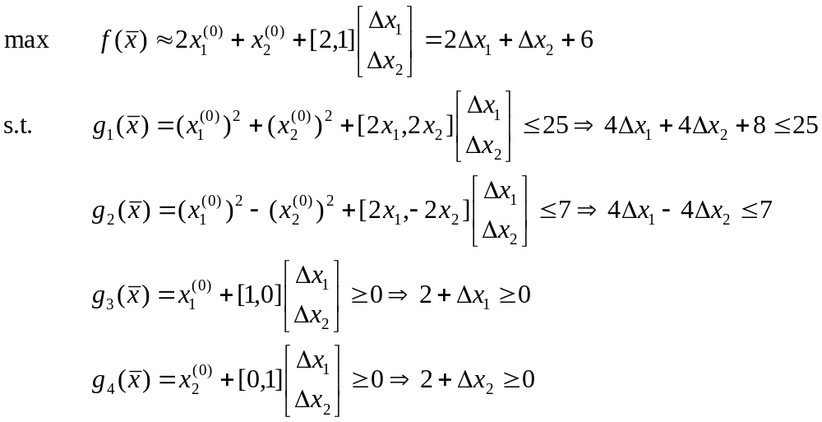
Setting up an LP subproblem
Here’s what I get:
CPE 778, Lect. 20

Slide 15
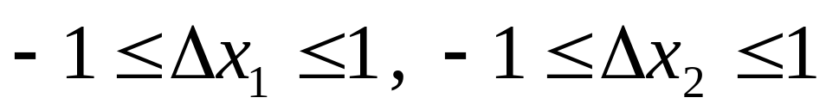
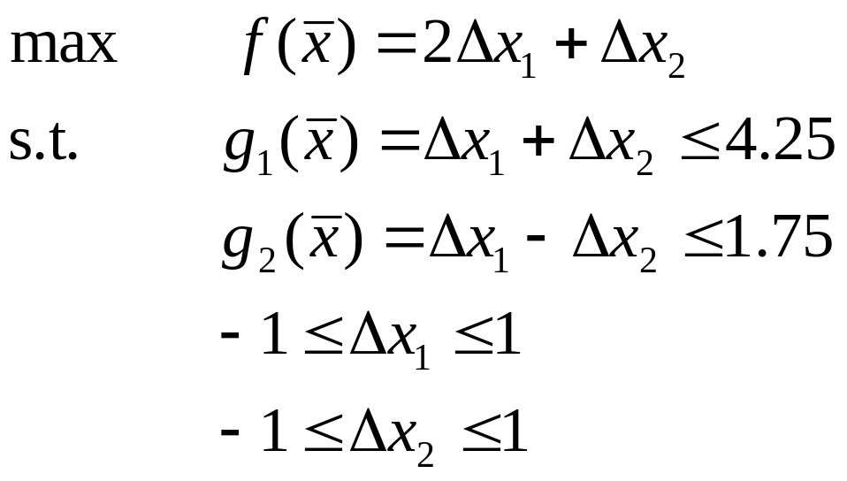
Setting up an LP subproblem
We also need bounds on the Δx’s, to keep the Taylor series approximations reasonably accurate:
Now put all these together and simplify:
This is called an LP subproblem. Solve using the simplex method
CPE 778, Lect. 20

Slide 16
LP subproblem #1
6
5
4
x₂
3
2
1
1
2
3
4
5
6
7
8
x₁
Note the optimum lies at [3,3] – we moved as far as we could. No original constraint is active.
CPE 778, Lect. 20

Slide 17
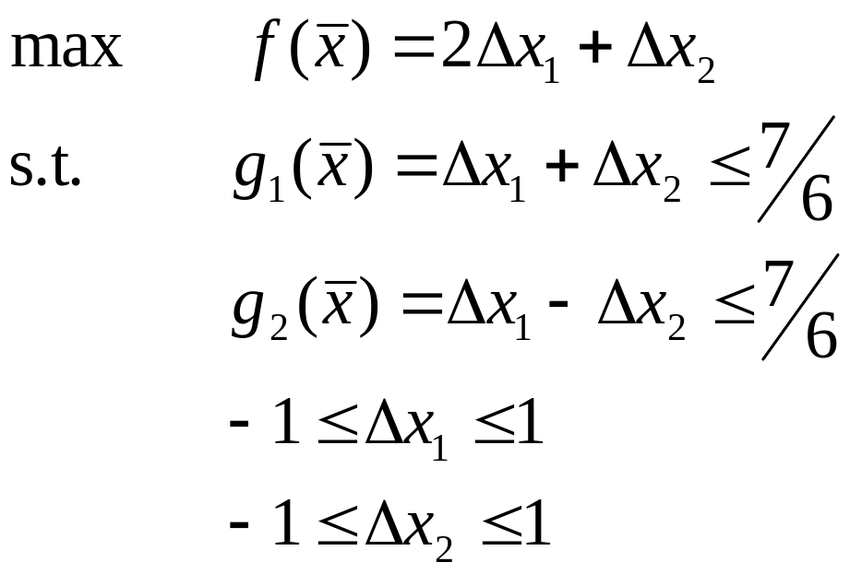
LP subproblem #2
Now, check and make sure [3,3] is better than [2,2], to make sure we’re converging.
f(2,2)=6, f(3,3)=9, OK
Now set up the next LP, by linearizing around [3,3]:
CPE 778, Lect. 20

Slide 18
Further Iterations
The solution to LP #2 is [4,3.167]
Note this is infeasible to the original NLP – not a problem, but don’t use intermediate solutions!
After the third LP, we get to [4,3.005], still infeasible but very close to the optimum
This method does not always converge, but an improvement does:
Penalty Successive Linear Programming changes the step bounds in each step using a penalty function, causing the method to never step too far and thus always converge
This method is used in many commercial NLP codes, but sometimes converges slowly
CPE 778, Lect. 20

Slide 19
Conclusions
Penalty function and barrier function methods do not work well to solve NLPs as stand-alone algorithms, but many other methods use such functions to improve convergence
Successive Linear Programming converts the NLP to a series of LPs. This does work well, if we change the step bounds using a penalty function. Convergence can be slow for many-variable problems
CPE 778, Lect. 20

Slide 20
GRG: The Generalized Reduced Gradient Method
Iteratively solves a constrained NLP without relaxation
Includes a fast unconstrained NLP solver, and deals with each constraint separately
Implemented in CONOPT within the GAMS modeling system
CPE 778, Lect. 21

Slide 21
GRG: Ideas
If we could put all constraints into the objective function, or start from a feasible point at which no constraint is active, then we could perform at least one step of an unconstrained NLP algorithm and improve our initial guess. How do we make that step?
Compute grad f(x) at the current point
Test to see if the iterations are converging
Compute a search direction based on grad f(x) (like steepest descent) plus other information
Perform a line search to figure out how far to move in the search direction
Repeat if still “unconstrained”
CPE 778, Lect. 21

Slide 22
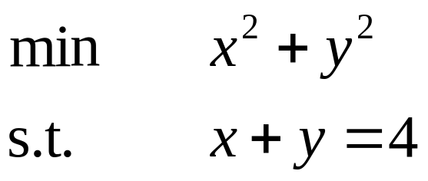
GRG: Dealing with Constraints
Simplest case – a linear equality constraint
  We can solve for one variable and eliminate it from the other constraints and from the objective function
Example:
4.0
3.0
2.5
2.0
y
1.5
1.0
0.5
0.5
1.0
1.5
2.0
2.5
3.0
3.5
4.0
x₁
CPE 778, Lect. 21

Slide 23
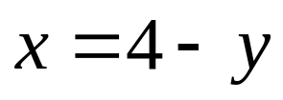
Basic Variables for GRG
Rearrange the constraint to get
Call the variable being substituted out of the problem basic
All other variables are considered non-basic
CPE 778, Lect. 21

Slide 24
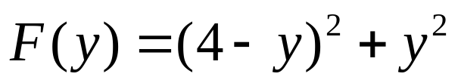
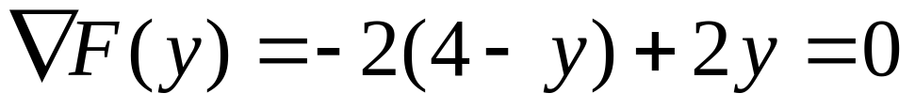
Substituting In
Put this in the objective function:
Now we can solve by setting the derivative =0 (GRG does this automatically for differentiable functions):
This is called the reduced gradient, hence the name GRG
CPE 778, Lect. 21

Slide 25
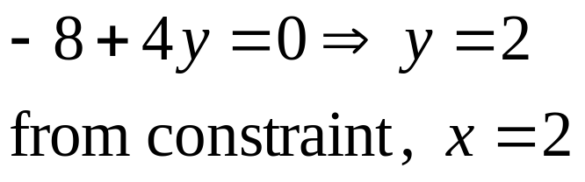
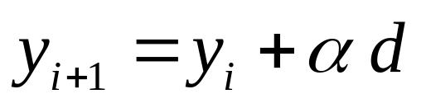
Using Steepest Descent
Solve this to find x,y:
What if we used the descent algorithm here? We could get a new value for y using
Start with a feasible point – how do we find one?
Note we have one degree of freedom in the constraints – set y=0, solve for x: [4,0]
CPE 778, Lect. 21

Slide 26
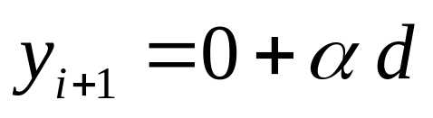
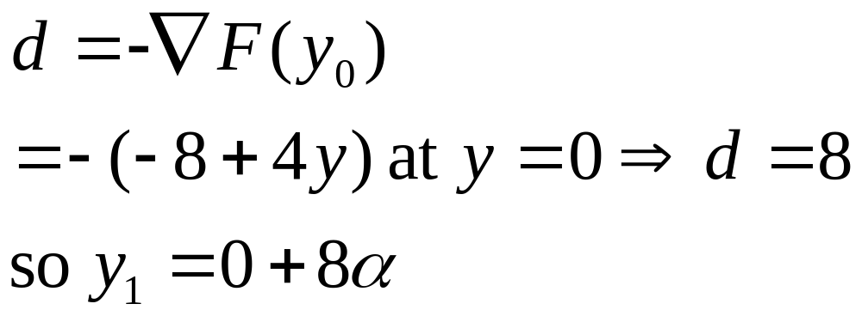
More Steepest Descent
Now we get
What is d?
The negative gradient:
CPE 778, Lect. 21

Slide 27
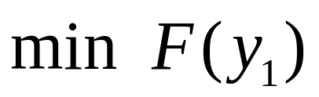
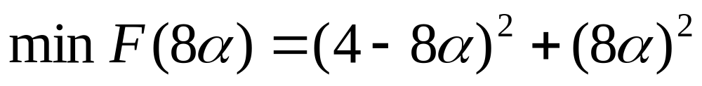
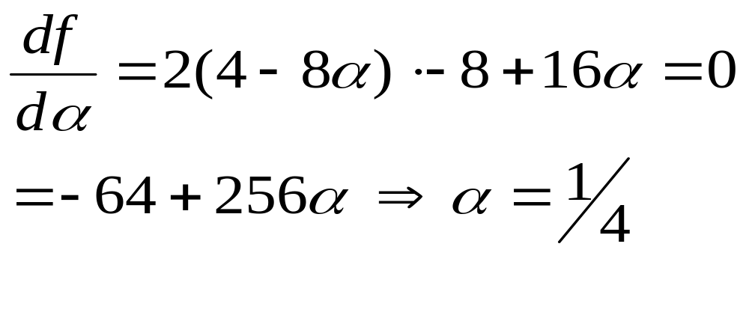
Performing the Line Search
Now we need to find α: Solve
This becomes:
Solve by taking the derivative again:
CPE 778, Lect. 21

Slide 28
GRG: Details
What if the equality constraint is nonlinear?
GRG uses an approximation procedure similar to Newton’s method to solve for the basic variables
How do we handle inequalities?
Add slack variables
CPE 778, Lect. 21

Slide 29
Superbasic Variables
If we have inequality bounds on variables, these can cause convergence of GRG to be slow if we wish to remain feasible at every iteration
If we allow some variables to violate their bounds, those variables are called superbasic for a given iteration
GRG within GAMS is efficient because it makes wise choices for basic, non-basic and superbasic variables
CPE 778, Lect. 21

Slide 30
Basic Algorithm
Tabu search is a stochastic algorithm which is primarily used to solve large NLP and MINLP problems. As with simulated annealing, we need a way to escape local minima (particularly if they are shallow).
To set up the algorithm, you need to define a move, that is, a way to change the variables of the system to get from one feasible solution to the next. In Tabu search, the size (distance) of the move can change based on the local environment, and based on the history of the search process
CPE 778, Lect. 22

Slide 31
Tabu Search: Basic Ideas
As with all stochastic algorithms, TS requires an initial feasible solution. It can be parallelized naively just by running multiple simultaneous searches, and comparing results at the end
At each iteration, TS computes a set of random moves, and accepts the best move unless the move makes the solution infeasible, or the new point is on the Tabu list.
  A prespecified number of previously visited solutions are stored in the Tabu list
  This forces the search out of shallow minima, and prevents cycling
  A very good solution can be revisited by overruling the Tabu restriction.
CPE 778, Lect. 22

Slide 32
More Uses of the Tabu List
After a few moves, we can tell if the solutions are improving or not. If we look to be in a local well, then use local intensification: decrease the size of the moves to narrow in on a likely good local minimum
If the area is unpromising, then use diversification: make a large move in a random direction, and restart the search. Do not reset the Tabu list, in case the new area has been searched in the recent past
Using the history of the search in this way is called an Adaptive Memory Strategy
CPE 778, Lect. 22

Slide 33
Adaptive Memory
The use of information from previous iterations is common in numerical analysis, not just in optimization. Can you think of any mathematical methods which use previous history to help lead to an improved solution?
  In control theory, one uses the integral of the process output over time to help predict how the controlled variable will change in the future, and thus design a corrective action
  In conjugate gradient optimization, both current and prior derivative information is used to derive the next iterate. This leads to better search directions than Newton’s method, which only uses current information
CPE 778, Lect. 22

Slide 34
Adjustable Parameters
TS has a number of adjustable parameters, which should be varied in order to improve solutions times on a given problem. They include:
  Length of the Tabu list
  Number of solutions considered in each step
  Number of iterations with no improvement prior to diversification
  Amount of improvement required to initiate local intensification
  For problems with continuous variables, how “close” two solutions must be for them to be considered identical
CPE 778, Lect. 22

Slide 35
Integer Programs in Engineering
Many engineering problems require the use of discrete variables, to represent
  Numbers of batches
  Fixed choices of equipment types
  Locations of equipment, facilities, wells
  Tasks to be performed within a given time period
  Network connections: piping, electrical grids, roads, heat exchangers, reactors, molecules
  Selection of solvents, catalysts, reaction chemistries
Often, assuming continuous variables and rounding leads to a (significantly) nonoptimal solution
CPE 778, Lect. 23

Slide 36
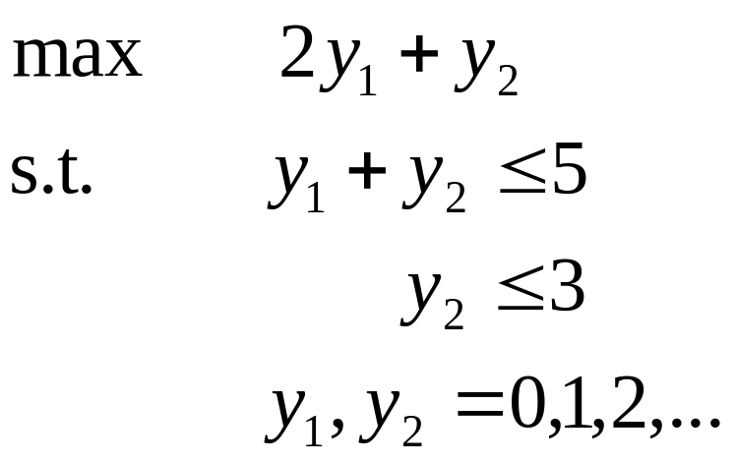
Feasible Region: MILP
Sketch the feasbile region for
y₂
5
4
3
2
1
1
2
3
4
5
y₁
Note this is an MILP, and the solution is at [5,0] – a corner of the simplex
CPE 778, Lect. 23

Slide 37
Classification of Integer Programs
Specific types of integer programs have been named and some have specialized solvers:
All variables binary ([0,1]): binary program, BIP
All constraints and objective linear, both continuous and integer variables: MILP
  Like an LP, only global solutions
  Must deal with combinatorial explosion
All variables integer, all equations linear: pure IP
Anything with nonlinear functions & some integer or binary variables: MINLP
  Clearly the toughest, many local solutions, combinatorial explosion
CPE 778, Lect. 23

Slide 38
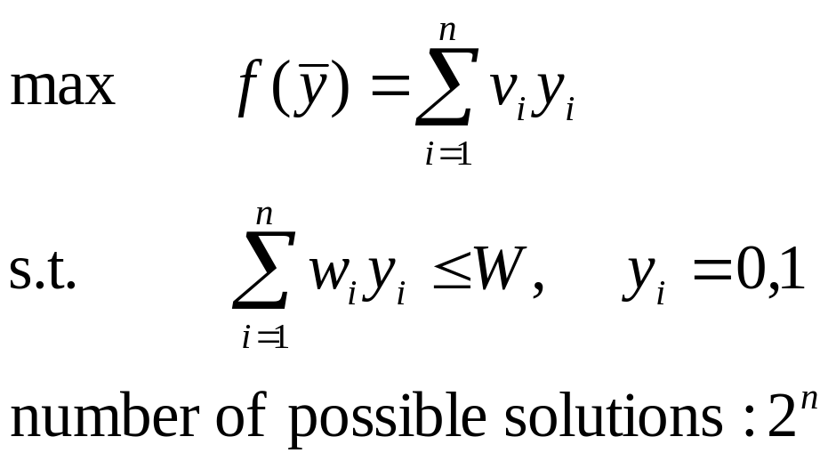
Example: Chemical Engineering
A consultant has n jobs which have been offered to her. Each task requires w_{i} hours to perform, and the consultant will be paid v_{i} dollars if she completes the i^{th} task. Select a subset of the tasks which can be performed within W total hours which maximizes the consultant’s income. (Called a knapsack problem)
Formulate this and compute the number of possible (not just feasible) solutions.
CPE 778, Lect. 23

Slide 39
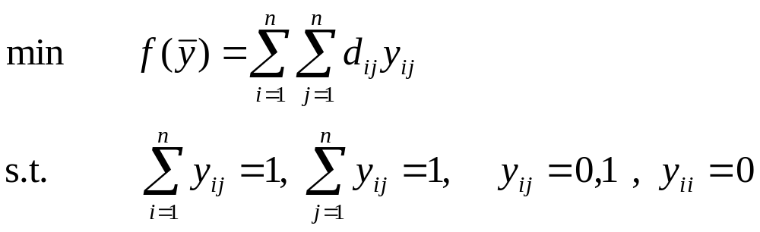
Example: Economics
A sales rep must visit clients in n cities. The distance between each city is known, and the sales rep needs to visit each client once, and return home. What order should the cities be visited in to minimize the distance traveled? (Called the Traveling Salesman Problem or TSP)
Is that all we need?
CPE 778, Lect. 23

Slide 40
Assignment problems and TSP’s
The problem as stated is called an assignment problem, and allows solutions like:
To avoid these solutions, we need a “no subtours” constraint – adds many equations and variables
CPE 778, Lect. 23

Slide 41
TSP’s in Chemical Engineering
Given a batch reactor in a flexible chemical plant which can make n specialty chemicals, derive the order in which you make each product. You know the changeover costs to switch from making product i to product j, you must make all n chemicals, and you wish to minimize total production costs
This is a TSP as well – very tough to solve for large n
CPE 778, Lect. 23

Slide 42
Bounding the Solution
What happens if we remove the integrality restrictions?
We get an LP, the solution to which is always ≥ the solution to the MILP (an upper bound)
We can use the solution at any feasible point as a lower bound
y₂
5
4
3
2
1
1
2
3
4
5
y₁
The branch-and-bound method brings these bounds together to narrow the search until the optimum is found
CPE 778, Lect. 23

Slide 43
Conclusions
Problem Formulation ideas:
    Binary/integer variables are heavily used in industrial engineering applications, when rounding leads to huge errors
    “Selection” problems are often modeled with binary variables, for which special relationships exist that can be used to avoid nonlinearities
    Remember to only use an integer/binary variable when necessary, since each one increases the complexity of the problem greatly
CPE 778, Lect. 23

Slide 44
Review: MILP Bounding
What happens if we remove the integrality restrictions?
We get an LP, the solution to which is always ≥ the solution to the MILP (an upper bound)
We can use the solution at any feasible point as a lower bound
y₂
5
4
3
2
1
1
2
3
4
5
y₁
The branch-and-bound method brings these bounds together to narrow the search until the optimum is found
CPE 778, Lect. 24

Slide 45
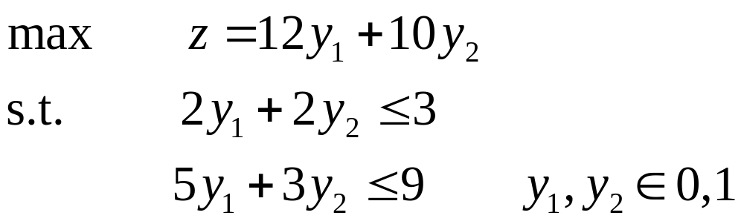
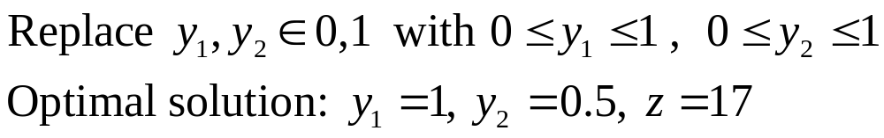
Branch and Bound: A Small Binary Example
Let’s solve the following binary program:
First, solve the LP-relaxation, called the root node of the problem:
CPE 778, Lect. 24

Slide 46
LP-relaxation: Binary Example
Remember the LP-relaxation gives an upper bound on the solution
If it is feasible to the original problem, it is the global optimum of that problem
Normally, as in this case, it is infeasible
CPE 778, Lect. 24

Slide 47
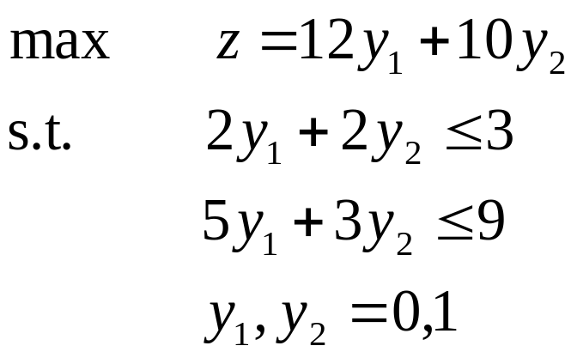
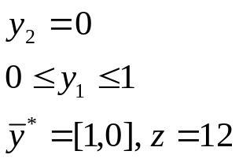
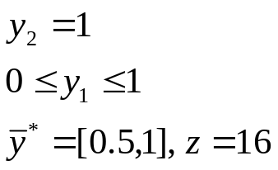
Binary Trees
Start by drawing the root node at the top
Next, branch on a variable which did not have an integer value, and set up two new
problems
What type of problems are these?
y₁=1
y₂=0.5
UB=17
LB= -∞
y₂=0
y₂=1
UB=17
LB=12
B.I.=[1,0]
gap=5
UB=17
LB= -∞
They are easier LP’s! Solve to get:
CPE 778, Lect. 24

Slide 48
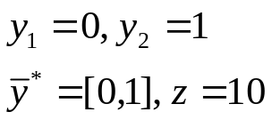
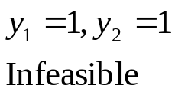
Binary Trees, continued
Now we have valid upper and lower bounds, and an integer solution. Are we done?
y₁=1
y₂=0.5
UB=17
LB= -∞
y₂=0
y₂=1
UB=17
LB=12
B.I.=[1,0]
gap=5
UB=17
LB= -∞
y₁=0
y₁=1
No. A branch is fathomed when we get an integer solution, or the resulting problem is infeasible. We must still
fathom the right branch:
Now all leaves are evaluated. The best integer solution is the optimum.
CPE 778, Lect. 24

Slide 49
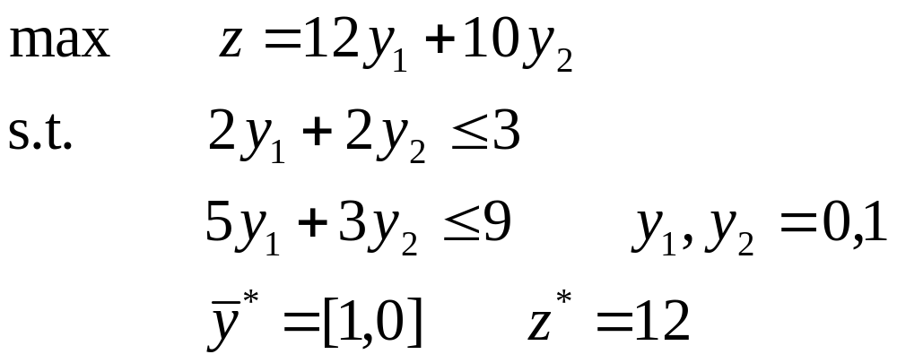
Complexity Issues
Note we had to evaluate 2^{n}=4 nodes – all possibilites.
Leaves above the top of the tree give LP’s to solve, but uppermost leaves are just evaluations
We need a bigger example to see how branch and bound can eliminate groups of nodes
CPE 778, Lect. 24

Slide 50
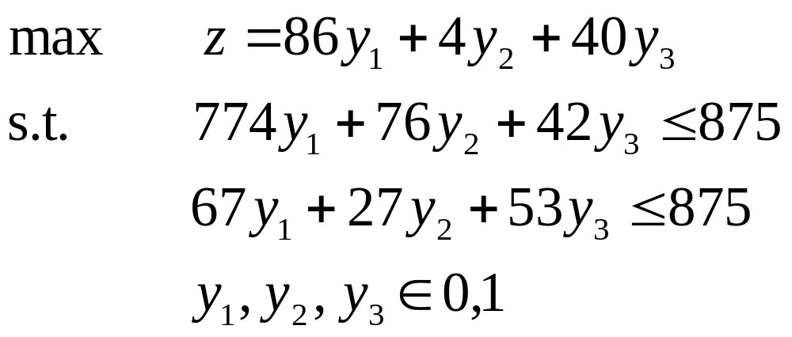
Large Binary Example
Here’s a larger example from your book:
Again, solve the LP-relaxation (the root node)
What if the LP-relaxation has no feasible solutions?
Then the original problem has no feasible solutions, and we are done
CPE 778, Lect. 24

Slide 51
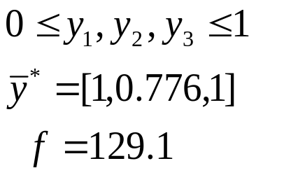
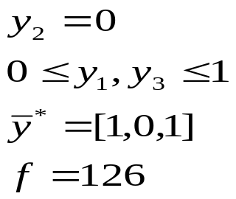
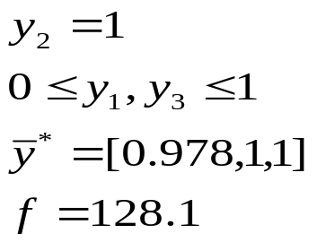
Binary Tree – Large Example
Now branch on the fractional variable y₂
UB=129.1
LB= -∞
y₂=0
y₂=1
UB=129.1
LB=126
B.I.=[1,0,1]
UB=128.11
LB= 126
Now branch on the fractional variable y₁
CPE 778, Lect. 24

Slide 52
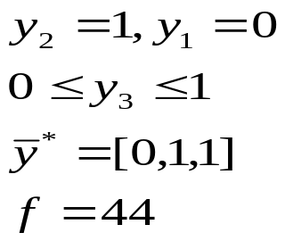
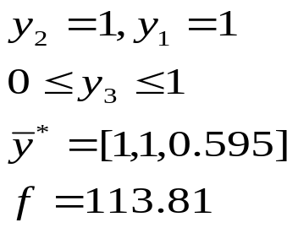
Binary Tree – Large Example
What are the upper and lower bounds after exploring the last node?
UB=129.1
LB= -∞
y₂=0
y₂=1
UB=129.1
LB=126
B.I.=[1,0,1]
UB=128.11
LB= 126
y₁=0
A
y₁=1
B
UB=128.11
LB=126
B.I.=[1,0,1]
UB=113.81
LB=126
This means we do not need to further explore node B!
CPE 778, Lect. 24

Slide 53
Explicit and Implicit Fathoming
Since f=44 for node A (an integer solution), this gives a lower bound which is lower than f=126. So we discard this solution. The node is explicitly fathomed.
Since f=113.8 for node B (a non-integer solution), this serves as an upper bound to that branch. All solutions below this one will be more constrained, and have a solution ≤ 113.8. Since this is below LB=126, none of these solutions can be optimal.
This is called implicit fathoming
CPE 778, Lect. 24

Slide 54
Further Ideas – Branch and Bound
What if we have more than one fractional value to branch on?
There are many ways to make the decision – none are optimal for all problems, and all give the same final answer (some take longer)
How much time did we save using B&B?
  We solved 5 LP’s, instead of evaluating 8 nodes
  We never needed to evaluate [0,0,0], [0,0,1], [0,1,0], [1,0,0], [1,1,0], [1,1,1]
CPE 778, Lect. 24

Slide 55
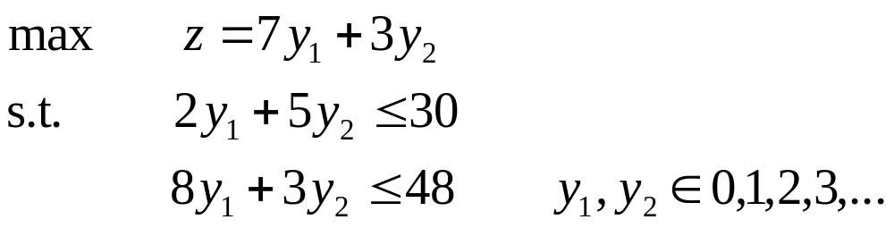
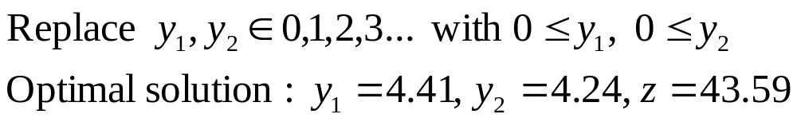
Branch and Bound: Integer Example
Let’s solve the following integer program:
Again, solve the LP-relaxation, called the root node of the problem:
CPE 778, Lect. 25

Slide 56
LP-relaxation: Integer Example
Remember the LP-relaxation gives an upper bound on the solution
If it is feasible to the original problem, it is the global optimum of that problem
Normally, as in this case, it is infeasible to the original MILP
CPE 778, Lect. 25

Slide 57
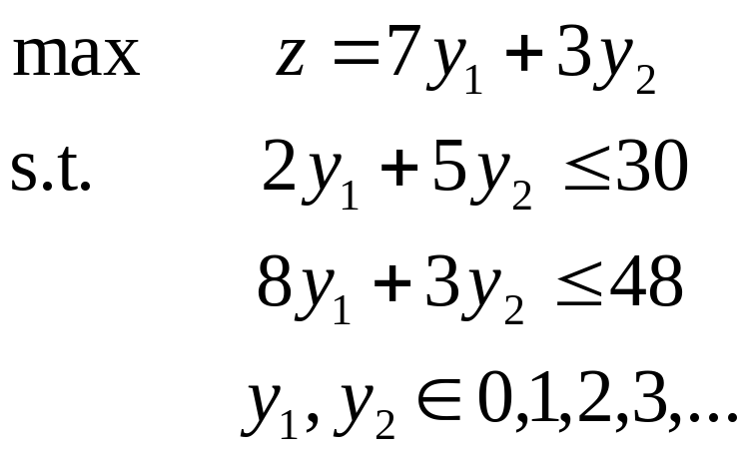
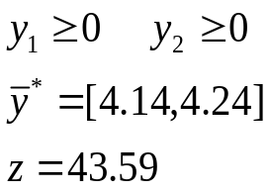


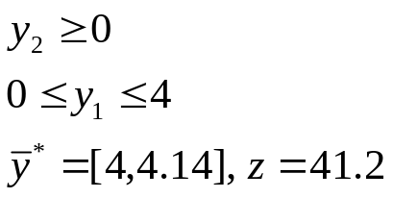
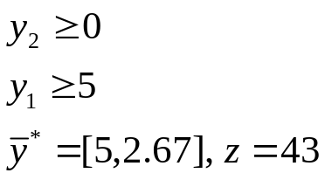
Binary Tree
Start by drawing the root node at the top
Next, branch on a variable which did not have an integer value:
What type of problems are these?
UB=43.59
LB= -∞
UB=41.2
LB=-∞
UB=43
LB= -∞
They are more constrained LP’s!
CPE 778, Lect. 25

Slide 58


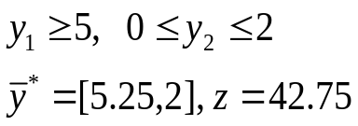

Binary Tree, continued
Now we must choose a branch to continue fathoming. Which should we choose?
UB=43.59
LB= -∞
UB=41.2
LB=-∞
UB=43
LB= -∞
The branch on the right has a higher upper bound, thus a better chance of having the optimal solution under it.
Always branch on a fractional variable
UB=42.75
LB= -∞
CPE 715, Lect. 25

Slide 59




Binary Tree, continued
UB=43.59
LB= -∞
UB=41.2
LB=-∞
UB=43
LB= -∞
Now branch again on the leaf with the highest UB:
UB=42.75
LB= -∞
Note that variables can get constrained to be one value
UB=42.75
LB= 41
UB=42.75
LB= 42
CPE 778, Lect. 25

Slide 60
Binary Tree, continued
UB=43.59
LB= -∞
Are we done?
UB=41.2
LB=-∞
UB=43
LB= -∞
Yes. The lower bound (z=42) is higher than the upper bound for all nodes not explicitly fathomed
UB=42.75
LB= -∞
UB=42.75
LB= 41
UB=42.75
LB= 42
Optimal solution: [6,0], z=42
CPE 778, Lect. 25

Slide 61

Complexity Issues
Note we had to evaluate 6 nodes out of...
An infinite number! (if infeasble possibilities counted)
Even if we only count feasible solutions, there are 33 possibilities
So this is efficient, even though we must sometimes solve a large number of LP’s
CPE 778, Lect. 25

Slide 62
NP-Completeness
These problems are NP-complete
  No known algorithm solves them in “polynomial time”
  Even simple-looking problems can take a huge amount of time to solve
It is therefore critical to formulate your problem in a way which is likely to be solvable within a reasonable time
CPE 778, Lect. 25

Slide 63
Hints: Computer Solution of MILP’s
Do you really need all those integer variables?
  If a value is very large, then assuming that it is continuous followed by rounding it only introduces a small amount of error
  How much uncertainty exists in your parameters anyway?
Set the tightest bounds possible on your integer variables
  Causes branches of the tree to be fathomed more quickly
CPE 778, Lect. 25

Slide 64
More Hints: Computer Solution of MILP’s
Have we seen this before?
  Many “classic” problems have specific solvers (software) created just to handle them, like TSP’s and assignment problems
  Try to formulate your problem like one of these, and get software which is effective for that type of problem
CPE 778, Lect. 25

Slide 65

More Hints: Computer Solution of MILP’s
Try not to mix integers and binaries
  This causes two types of branching rules to be enforced simultaneously, which slows down the solver
  For just a few integer variables, you can convert them to binaries using:
  where n is the no. of binary digits needed to store x
CPE 778, Lect. 25

Slide 66
Production Sizing with Batch Processes
Many chemical plants produce multiple products from similar feedstocks
  Quickly meet changing demands
  Flexibility if one production or supply line gets interrupted
  Improve profits relative to a one-product plant
Let’s look at a small example of a production planning problem:
CPE 778, Lect. 26

Slide 67
Batch Sizing
Due to shutdown and startup costs, batch sizes are constrained to be 2000 lb for P1 and P2
Formulate this problem by addressing the following issues:
  Scale the problem to avoid numerical difficulties
  Write the objective function
  Write the constraints
CPE 778, Lect. 26

Slide 68


One Possible Formulation
Scaling: x₁ is number of 1000 lb/day runs of P1, x₂ is number of 1000 lb/day runs of P2, profit in $1000/day
Objective function:
Constraint on B:
How do we write the batch size constraint?
CPE 778, Lect. 26

Slide 69


Batch Size Constraint
Using the variables previously defined, we need to make sure the number of batches is an even integer
To ensure this, invent new variables y_{i} such that:
This results in constraints on the y variables:
CPE 778, Lect. 26

Slide 70


The Complete MILP
So the final MILP problem is:
How would you solve this?
CPE 778, Lect. 26

Slide 71

Solution Methods
Low Tech Plan: Complete Enumeration
(30 possibilities)
High Tech Plan: use GAMS/CPLEX
Medium Tech Plan: use Excel’s LP solver, Branch and Bound
CPE 778, Lect. 26

Slide 72





Branch and Bound Solution
Start with the root node (LP-relaxation)
Next, branch on y₁:
UB = 2.8
LB = -∞
Both leaves fathomed, optimal solution is [2,5]
UB=2.8
LB= 2.64
UB=2.8
LB=2.64
B.I.S. = [2,5]
CPE 778, Lect. 26

Slide 73
Minimizing Manufacturing Costs
Assume we must produce a number of products j=1,...,n , with a cost C_{j} to produce one unit of j
Also, if we make any of a given product j, we must pay a fixed equipment cost K_{j}
There are also demands d_{j} to be satisfied
How do we formulate this? (hint: use a discontinuous constraint)
CPE 778, Lect. 26

Slide 74

A Discontinuous Formulation
We could use continuous variables x_{j} to store the amount of each product produced, and binary variables y_{j} to store whether any of a given product is produced:
Tough to solve!
We need a way to relate x and y in a linear and continuous manner
CPE 778, Lect. 26

Slide 75


Big-M Constraints
Assume that you have:
Then, to force y_{j} to be 0 when x_{j}=0, apply the new constraint
If x_{j}≠0, then y_{j}=1 by this constraint. If x_{j}=0, y_{j} will be forced to zero by the objective function
CPE 778, Lect. 26

Slide 76
Big-M Constraints, continued
Note these constraints are linear
To improve solution times, make the M’s as small as possible. Why?
This decreases the size of the feasible region for the LP-relaxations in the branch-and-bound tree
CPE 778, Lect. 26

Slide 77
Solving MILP’s via CPLEX
The key is to solve the LP-relaxations quickly
CPLEX has four algorithms to solve LP’s, and you can choose the best one for your problem:
  The Primal Simplex method (the one we discussed in this class)
  The Dual Simplex method: like the original simplex method, but uses information from the dual to speed things up
  The Barrier Algorithm, as discussed in class – good for large, sparse problems
  A specific solver for network flow problems
CPE 778, Lect. 26

Slide 78
Network Flow Problems
A subclass of LP’s
Each coefficient of A is either –1, 0 or 1
Each column and row of A has exactly two non-zero entries, one with a +1 and one with a –1
This problem occurs often in engineering:
  Machine scheduling
  Transportation problems (shipping between locations)
  Connectedness of electrical power networks
If you have a network flow problem, set the proper option in CPLEX – it has a very fast algorithm for this type of problem
CPE 778, Lect. 26

Slide 79
MINLP’s – a tough class of problems
MINLP’s have
  Both continuous and integer/binary variables
  Some nonlinear constraints and/or a nonlinear objective function
  Continuous, differentiable functions
There is no general algorithm to solve all MINLP’s
CPE 778, Lect. 27

Slide 80
Potential MINLP Solution Methods
We must overcome two major challenges to solve MINLP’s:
  Combinatorial Explosion
  Locally optimal points and saddle points
Previously, very little work done on this important class of problems
Current research focusing on two approaches:
  Relaxation techniques (deterministic)
  Random search methods (stochastic)
CPE 778, Lect. 27

Slide 81

Plant Design MINLP: General Structure
A plant design MINLP often looks like:
A specific, easier structure than the general MINLP
CPE 778, Lect. 27

Slide 82
Solving the Plant Design MINLP: Branch and Bound
We can use the Branch and Bound method for these MINLP’s as well
Remember the general B&B plan:
  Solve a relaxed problem to get an upper bound
  If you get an integer solution, it is a lower bound
  Use upper and lower bounds to implicitly eliminate nodes
  Branch on integer variables which come out fractional when solving a relaxed problem
CPE 778, Lect. 27

Slide 83
Branch and Bound for MINLP’s
What type of optimization problems occur when using B&B to solve an MINLP?
NLP’s. What happens if we get a locally optimal solution to one of these (but not global?)
This would give a false upper bound which is higher than it should be
We may also miss an integer solution for a local noninteger solution which is worse
CPE 778, Lect. 27

Slide 84
Solving the NLP relaxations
When can we be sure that we have the global optimum to an NLP?
Only if the feasible region is convex
Thus we would like the feasible region of all NLP relaxations solved within the B&B algorithm to be convex. When will this occur?
For our Process Design MINLP, only if:
  f(x) is convex
  h(x) are linear (tough to meet)
  g(x) are convex
CPE 778, Lect. 27

Slide 85
Dealing with the Limitations
What can we do if we don’t have convex feasible regions for all NLP’s?
Try multiple starting points, better algorithms to solve the NLP’s, hope for global optimality
Use different relaxations: DICOPT
Use a stochastic method which requires no relaxations at all
CPE 778, Lect. 27

Slide 86
Outer Approximation
Invented by Duran and Grossman (1986), improved by Floudas (1995) – all chemical engineers
  Uses different relaxations that B&B
  More robust than B&B (solves more types of problems)
  Implemented in the solver DICOPT
  Still, does not always solve nonconvex MINLPs
CPE 778, Lect. 27

Slide 87
Outer Approximation – Basic Overview
Here’s the overall plan for the method:
  Fix all the integer variables, solve the resulting NLP to global optimality (upper bound)
  Linearize all nonlinear functions around the point found from the NLP relaxation. This gives an MILP – solve via B&B. Gives a lower bound if the original MINLP is convex
CPE 778, Lect. 27

Slide 88
Outer Approximation – Basic Overview
Here’s the rest of the plan:
  3. Repeat the NLP relaxation, but solve with different values for the integer variables. This may give a new upper bound.
  4. Again, linearize around the new NLP point. Repeat the MILP solve, but add these new constraints to the previous MILP. This gives a more constrained MILP, so the lower bound moves up. Convergence is guaranteed!
CPE 778, Lect. 27

Slide 89
Solving the Subproblems
How does DICOPT solve the NLP and MILP subproblems?
You decide. Conopt is the default solver for the NLP subproblems, CPLEX for the MILP subproblems
Sometimes, MINOS is faster for the NLP’s, or OSL may be faster for the MILPs
Change via the ‘option’ statement in GAMS
CPE 778, Lect. 27

Slide 90

General Structure: OA subproblems
CPE 778, Lect. 27

Slide 91


“Linearizing” the Objective
How can I linearize
Use a trick:
and now linearize f(x) using a Taylor series.
CPE 778, Lect. 27

Slide 92
Conclusions
Outer Approximation is a powerful solver for convex and nonconvex MINLPs
  Solves a sequence of NLPs and MILPs
  Guaranteed convergence to global optimum for convex problems
  Often can find the global optimum for nonconvex problems
  To speed this up, keep the number of binary variables small!
CPE 778, Lect. 27

Slide 93

Bender’s Decomposition - Subproblems
Divide the original MINLP constraints into two sets: the “easy” ones, usually linear, and the “tough” ones, usually nonlinear
Here’s the upper bounding problem, an NLP (minimizing):
CPE 778, Lect. 28

Slide 94

Bender’s Decomposition - Subproblems
While the upper bounding problem is the same as in OA, the lower bounding problem is different
Fix the x variables to get a pure binary program:
CPE 778, Lect. 28

Slide 95
Bender’s Decomposition – Lower Bound
Note that we add one Bender’s cut to the lower bounding problem per iteration, so the lower bound moves up
Remember the λ’s and u’s are known, but you need to store them from each NLP iteration to put them in the Bender’s cuts
Grossman proved that OA’s lower bound is tighter than with GBD, so we need fewer iterations. But GBD adds fewer constraints to each MILP subproblem, so each iteration is usually faster. The trade-off sometimes favors GBD
CPE 778, Lect. 28

Slide 96
Bender’s Decomposition - Implementation
How could we implement an iterative scheme like GBD within GAMS?
If no prewritten solver is available, then we could solve the sequence of NLPs and MILPs directly:
  Write all the equations for both subproblems in one .gms file
  Use the Model statement to select the NLP and MILP equations
  Use var.l within equations to set x^{k}, y^{k} to values computed in previous solve
CPE 778, Lect. 28

Slide 97
Iterative Solving in GAMS
Once you have the two models set up, you need to solve them repeatedly
So put the solve statements in a loop:
  Loop (i,
  y1.fx=y1.l y2.fx=y2.l ...
  Solve UBP using NLP minimizing z;
  x1.fx=x1.l ...
  Solve LBP using MIP minimizing zp;
  test for convergence
  ) ;
CPE 778, Lect. 28

Slide 98
Stochastic Algorithms
A totally different class of algorithms than the deterministic ones we’ve been using:
  No relaxations
  No upper bounds (maximization)
Use random numbers to generate search directions
Accept a new point with a given probability
No guarantees of convergence
CPE 778, Lect. 29

Slide 99
Stochastic Algorithms - Advantages
Only use function evaluations
  No requirements of continuity, differentiability, linearity, convexity
  Do not even need a closed-form expression for constraints or objective function!
Simple to implement
Highly parallelizable
Generate numerous feasible, near-optimal solutions quickly
CPE 778, Lect. 29

Slide 100
Stochastic Algorithms - Examples
Simulated Annealing
  Based on simulations of materials (Metropolis, 1953)
  Accept a move to an inferior solution with a decreasing probability
Tabu Search
  Use a memory list to avoid repeating old solutions, escape local optima
  Apply local intensification to converge on optimum when a sufficiently good solution is found
CPE 778, Lect. 29

Slide 101
Stochastic Algorithms - Examples
Genetic Algorithms
  Evolve solutions from a random population, based on Darwinian principles
Ant Colony Optimization
  Ants derive shortest path from nest to food with almost no communication
  Good for graph/network problems in which data structures can be designed to emulate natural situation
CPE 778, Lect. 29

Slide 102
Example: Monte Carlo
Monte Carlo methods include any algorithm which uses random numbers to derive a solution
Why might it be preferable to use random numbers in a constrained search?
  No need to compute gradients or other derivative-based information
  For NLP and MINLP problems, we only have local information even if we analyze each constraint, and this can lead to early termination in a local solution
CPE 778, Lect. 29

Slide 103
Simulated Annealing
Simulated annealing is a stochastic algorithm which is primarily used to solve large NLP and MINLP problems. The goal is to improve on the basic steepest descent idea of just moving in the direction of greatest decrease of our objective function
To set up the algorithm, you need to define a move, that is, a way to change the variables of the system to get from one feasible solution to the next
CPE 778, Lect. 29

Slide 104
Moves
Let’s define moves for a set of optimization problems:
  Separation sequencing (assume we want each of a set of many components 99% pure)
    Start with an order of separation (ABCD → AB/CD→A/B/C/D) and then switch one component in one separation
  Molecular simulation
    Move each atom a small, fixed spatial distance
  Molecular design
    Change one functional group, or divert one bond and move hydrogens
CPE 778, Lect. 29

Slide 105
Beating Steepest Descent
A naive algorithm to find a local minimum would just make a random move (but only a feasible one), and if that move decreases the objective function, accept it. This will usually find the nearest local minimum, or saddle point
If we would like to look for the global optimum, we need to do something smarter
In the annealing of metals, a mixture of ores is heated very hot and then cooled very slowly, in the hope that is will reach its minimum Gibbs Free Energy conformation. Let’s apply this to an NLP problem.
CPE 778, Lect. 29

Slide 106

The Metropolis Algorithm
Based on that metals analogy, Metropolis (1953) proposed that moves which make the objective function lower be always accepted, but those which make the objective function worse be accepted with a probability of
The f’s are the objective function values at the current (i) and proposed new (j) states. k_{B} is Boltzmann’s constant, but what is T?
CPE 778, Lect. 35

Slide 107
Temperature Deprogramming
The T is called the control parameter, or commonly just the temperature. It allows the algorithm to slowly decrease that probability, with the hope that the algorithm has settled in the well which includes the global minimum, and then will not be able to escape that well and will reach that global minimum
There are many algorithms to choose how to decrease T, and the best one to choose depends on the problem. These functions are called temperature deprogramming schedules.
CPE 778, Lect. 29

Slide 108




Basic Algorithm
CPE 778, Lect. 29

Slide 109
Genetic Algorithms
Basic idea: simulate evolution to create improved solutions
  Start with an initial population of solutions (initial guesses)
  Alter them in some way (stochastically)
  Copy each of them with a given probability based on their “fitness” (objective value)
  Repeat steps 2-3, storing the best solutions
Challenges
  Parameters: population size, mutation/crossover probabilities, reproduction/death limits and probabilities
CPE 778, Lect. 30

Slide 110
Genetic Algorithms
Applications:
  MINLPs with many binary variables
  Multi-objective NLPs, MINLPs
  Black-box NLPs
  Multi-stage scheduling with adaptive objectives and/or constraints
  “Fuzzy” objectives or constraints
CPE 778, Lect. 30

Slide 111


Genetic Algorithms - Example
Start with a binary program:
Now set up an initial population:
Evaluate the “fitness” of these solutions. If infeasible, fitness=0. If feasible, fitness=z
CPE 778, Lect. 30

Slide 112


Genetic Algorithms:
Crossover & Mutation
Now alter the “genes” in some way:
  Mutation: flip a binary, randomly
  Crossover: swap the top halves of two solutions (choose parents, break point randomly)
CPE 778, Lect. 30

Slide 113
Genetic Algorithms: Recombination
Crossover and mutation are called recombination operators
Many other recombination operations are possible
The key to a successful GA is to use recombination operators which:
  Move quickly across the search space
  Produce new but still feasible offspring
  Generate steady improvement in the average fitness of the population
CPE 778, Lect. 30

Slide 114
Graphs and Networks – Basic Concepts
A graph is a set of points, called nodes or vertices, which may be connected via lines called edges, arcs, or branches
1
2
4
3
5
A path is a set of edges which connect two vertices (often through other vertices)
A connected graph contains a path between all vertices
CPE 778, Lect. 31

Slide 115
Adjacency
Two vertices are said to be adjacent or incident if they are directly connected by an edge
To represent a graph algebraically, we can use a binary variable: a(i,j)=1 if vertices i and j are adjacent, 0 otherwise
1
2
4
3
5
Thus for this graph, we have
a(1,2)=a(2,4)=a(2,3)=a(1,3)=1
CPE 778, Lect. 31

Slide 116

Adjacency Matrix
If we put all these binary variables together, we get an adjacency matrix:
1
2
4
3
5
Note an adjacency matrix of this type is symmetric, with all zeroes on the diagonal
CPE 778, Lect. 31

Slide 117
More Details about Edges
We need to add some information to each edge to represent many engineering problems
A graph is directed if we specify a direction for each edge
Each edge can also be assigned a weight, for example a flow capacity
18
1
2
24
4
15
3
6
5
CPE 778, Lect. 31

Slide 118


Capacity Matrix
Note the adjacency matrix is no longer symmetric:
18
1
2
24
4
15
3
6
5
We can also put the capacities in a matrix:
CPE 778, Lect. 31

Slide 119
More Details about Vertices
The degree of a vertex is equal to the number of edges which emanate from it.
A vertex can also be given a numerical weight (like an importance, or a capacity), or a classification, which is often called a color
Thus we can define problems which try to minimize the connections between different types of edges (partitioning) or find paths to minimize the distance between all vertices of the same color (clustering)
CPE 778, Lect. 31

Slide 120
Networks
A network is a connected graph with all edges directed and weighted
Many chemical/petroleum engineering problems are network design problems:
  Heat exchanger network synthesis
  Reactor network synthesis
  Piping and layout problems
  Scheduling and planning issues
CPE 778, Lect. 31

Slide 121

Oil Field Piping Problem: Formulation
Assume the production amounts from each well and all distances are known
The cost to build each pipe is
Formulate a network flow problem to build the network at minimum cost
CPE 778, Lect. 31

Slide 122

One Possible Formulation
What type of optimization problem is this?
A convex MINLP – solve via DICOPT
CPE 778, Lect. 31

Slide 123
Network Problems in C&PE
Many classic network optimization problems have direct application in C&PE:
18
1
2
24
15
21
4
3
8
5
12
The shortest path problem: given a network where the weights are distances, find a path between two nodes which is the shortest
The maximal flow problem: given a network where the weights are maximum flowrates, find the path which allows the maximum flow between two specified nodes
CPE 778, Lect. 32

Slide 124


Equipment Replacement Data
Prices for new equipment rise with time:
But so do maintenance costs:
CPE 778, Lect. 32

Slide 125
Example – Shortest Path Problem
Now put these weights on the graph:
The shortest path from 1 to 6 is the minimum cost strategy
How would we store this information algebraically?
Put all values in a cost matrix
53.7
84.1
33.8
35.5
25.8
1
2
22.8
3
24.8
4
28.8
5
6
20.8
27.8
33.8
29.8
39.5
55.7
37.5
CPE 778, Lect. 32

Slide 126

Cost Matrix
Define x_{ij} as 1 if the edge between years i and j is followed, 0 otherwise
Then C_{ij} is the cost of buying the equipment in year i and replacing it in year j
We can put these values in a cost matrix:
CPE 778, Lect. 32

Slide 127

Mathematical Formulation
Given the data structures x_{ij} and C_{ij} , we formulate this as an optimization problem:
You could certainly code this in GAMS and solve it. But there is a specialty algorithm, which is faster, and we’ll work on using that method by hand next time.
CPE 778, Lect. 32

